Slide 1
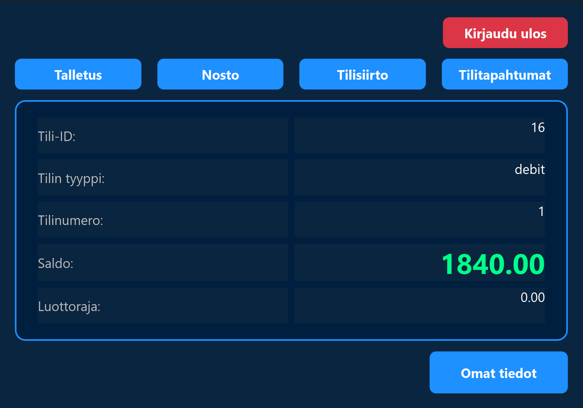
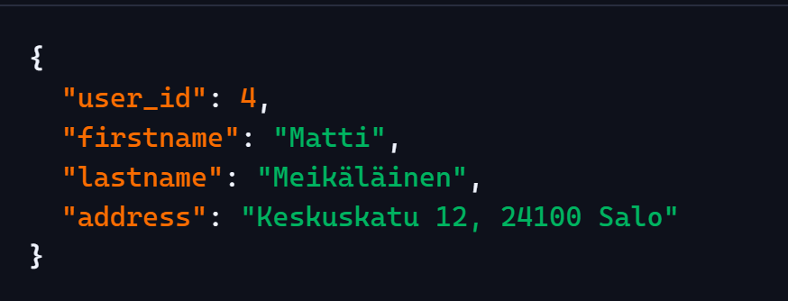
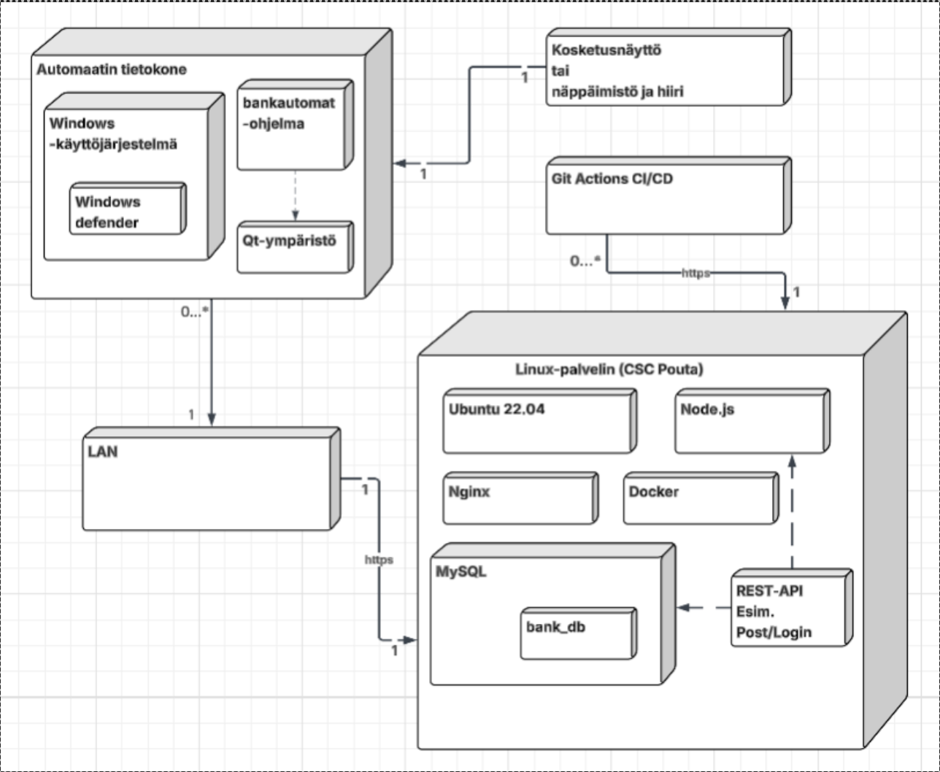
Automated Banking System
Valtteri Sippala, Vili Virnes, Aleksi Jussila, Santeri Rautio
TVT25KMO
Degree Programme in Information Technology, Option of Software Development
Introduction
The aim of this project was to develop automated banking system. Software uses Qt Creator in frontend application, Node.js/Express for backend API and MySQL as database.
Objectives
The objective was provided card-based authentication, balance inquiries, cash withdrawals, deposits, and transfers between accounts. The system was designed so that the Qt User interface communicates with the Node.js Backend, which processes the requests and interacts with the MySQL Database. As an additional feature, the backend is hosted on a CSC Pouta virtual machine using GitHub Actions for CI/CD.
FIGURE 1. The system description.
Methods
The User Interface was implemented using Qt (C++). Communication between The User Interface and the Backend was carried out using HTTP request and JSON-formatted data.
FIGURE 2. JSON response.
Results
The project culminated in a functional ATM application. Upon launching the application, users are prompted to enter their card number and pin code. Once a valid card number and pin code is provided users are presented with debit/credit selection window or the main window. In the main window user can view account information, balance and card number. Also user is presented with options to withdrawal cash, deposit money, transfer funds, view account transactions, access personal information or log out.
FIGURE 3. Application main view.
Conclusions
The project helped us understand the project as a whole and its development. Everyone got to work on the backend and frontend. This also allowed us to develop teamwork skills. We gathred valuable experience about version control and GitHub.
References
Qt Documentation. URL: http://doc.qt.io
Node.js Documentation. URL http://nodejs.org/en/docs
MySQL Reference Manual. URL:
https://dev.mysql.com/doc/
Software Development Application Project
ECTS Credits: 15
Date of Publication: 2026 Spring
Instructors: Pekka Alaluukas, Teemu Korpela

